Slide 1

2025 Community Needs Assessment
Southwestern Minnesota Opportunity Council

Slide 2

Methodology:
We used various methods to achieve a broad range of responses
Survey Monkey (91 responses)
QR code or weblink
Multiple language option
Social Media
Website
Direct mailings to Head Start and EAP households (20 responses)

Slide 3
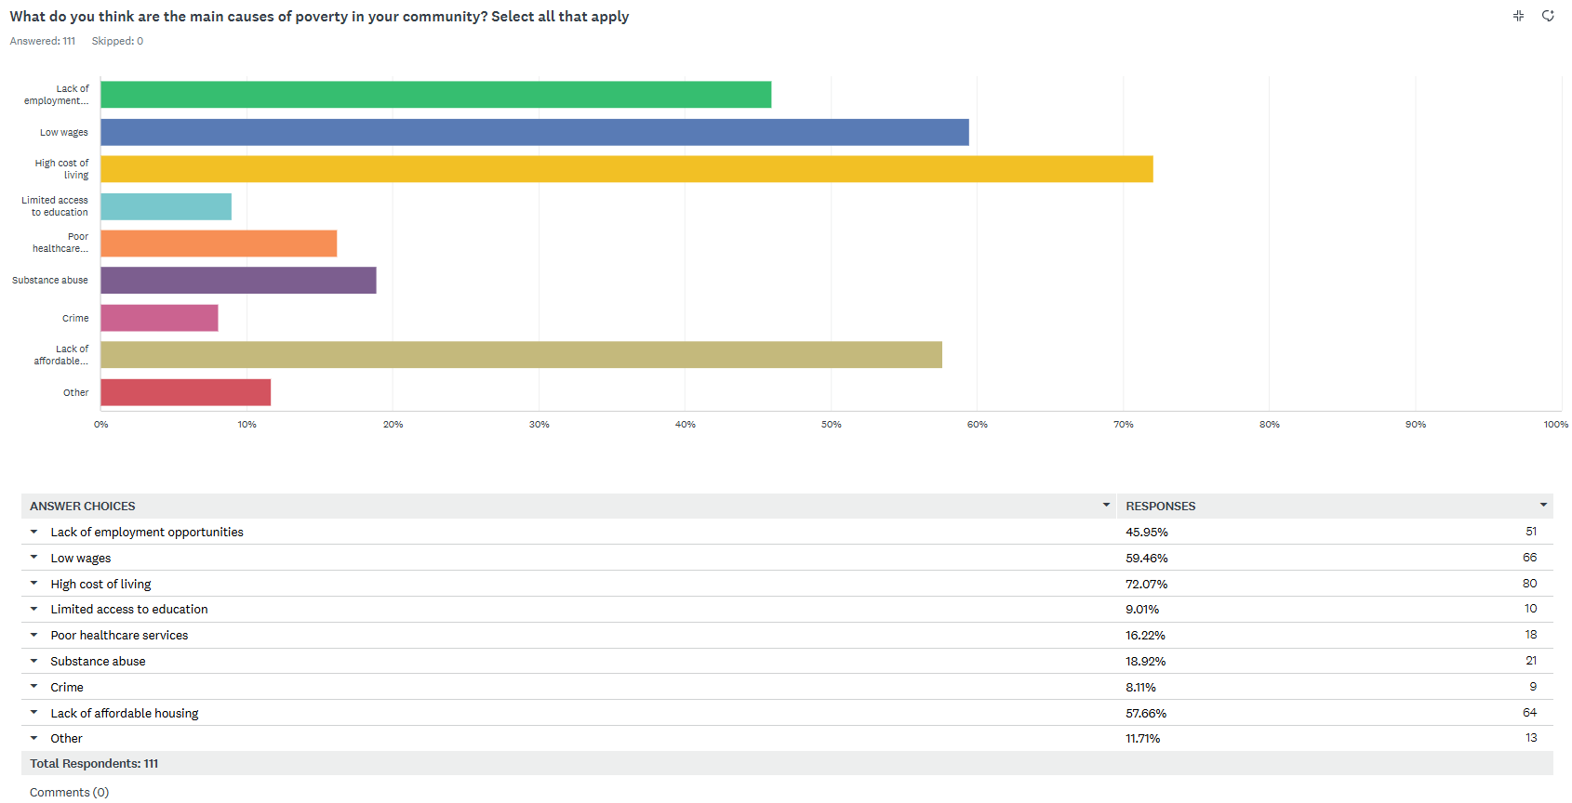

Slide 4
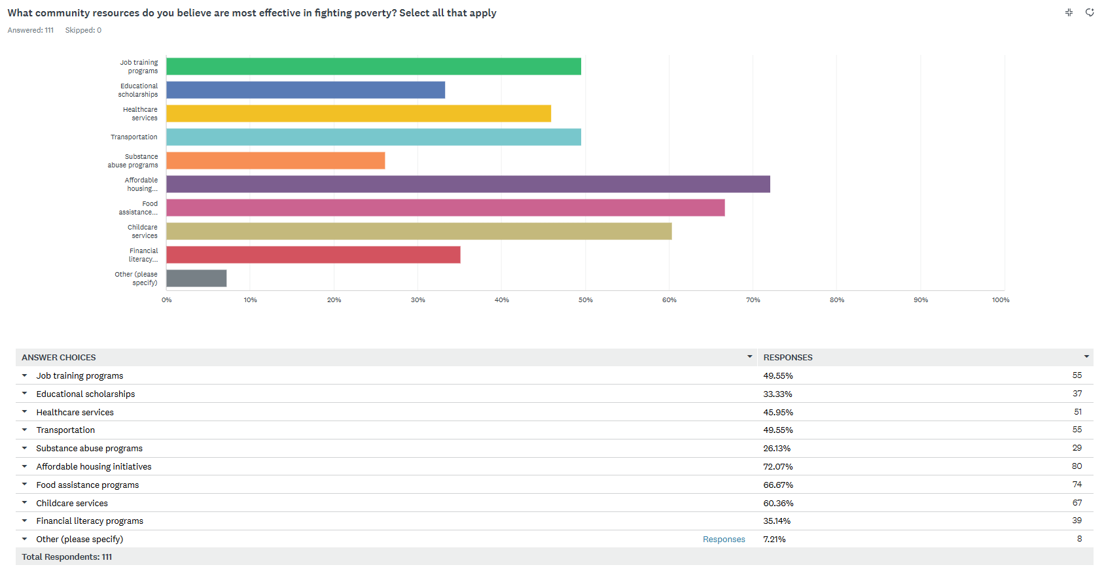

Slide 5
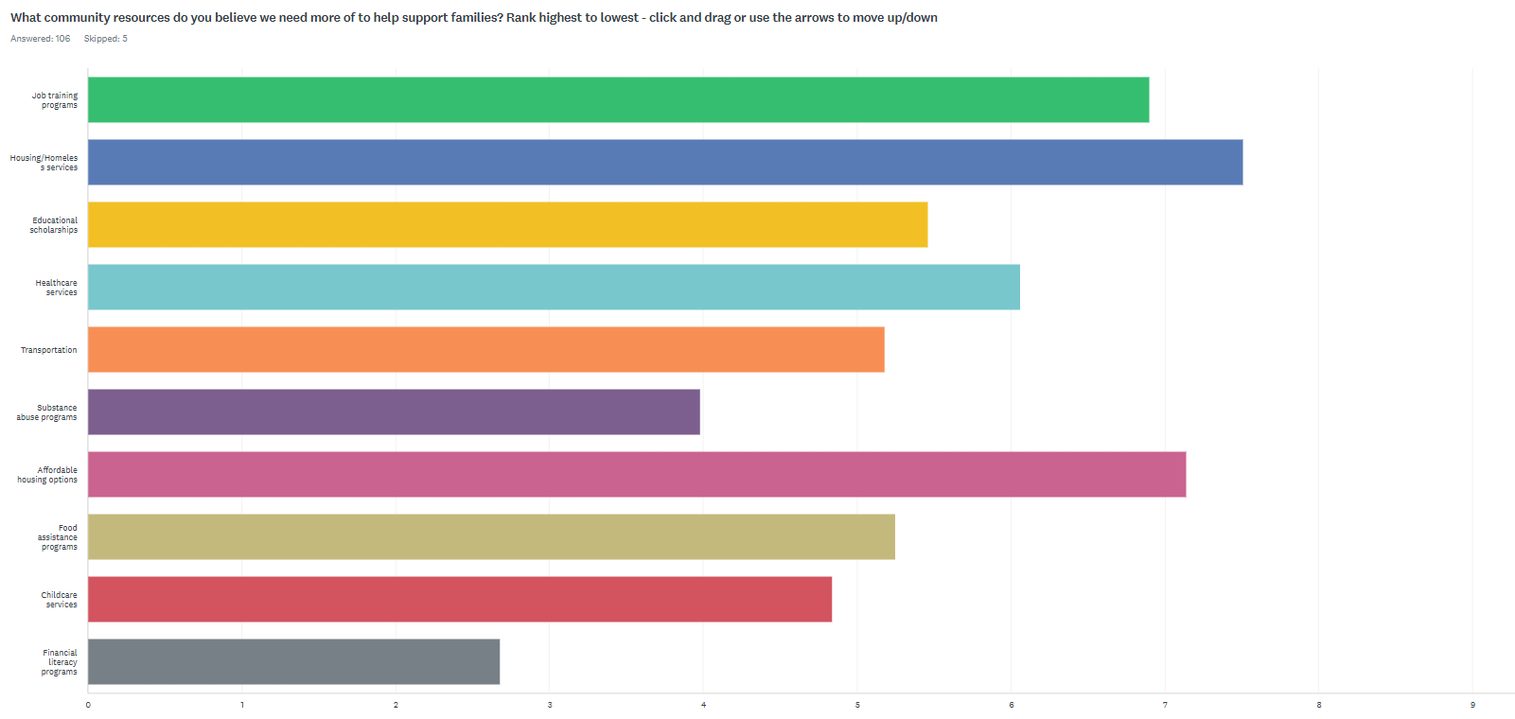

Slide 6
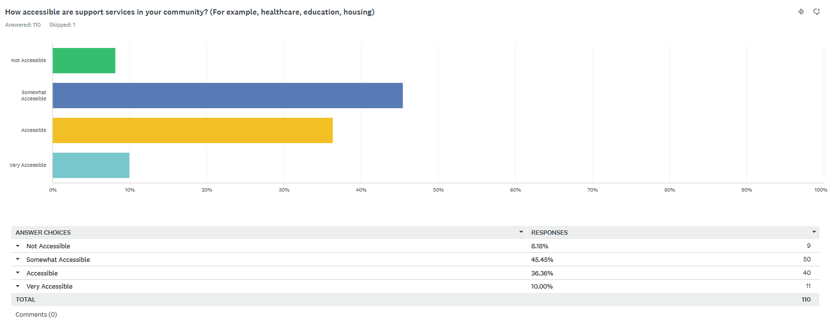

Slide 7
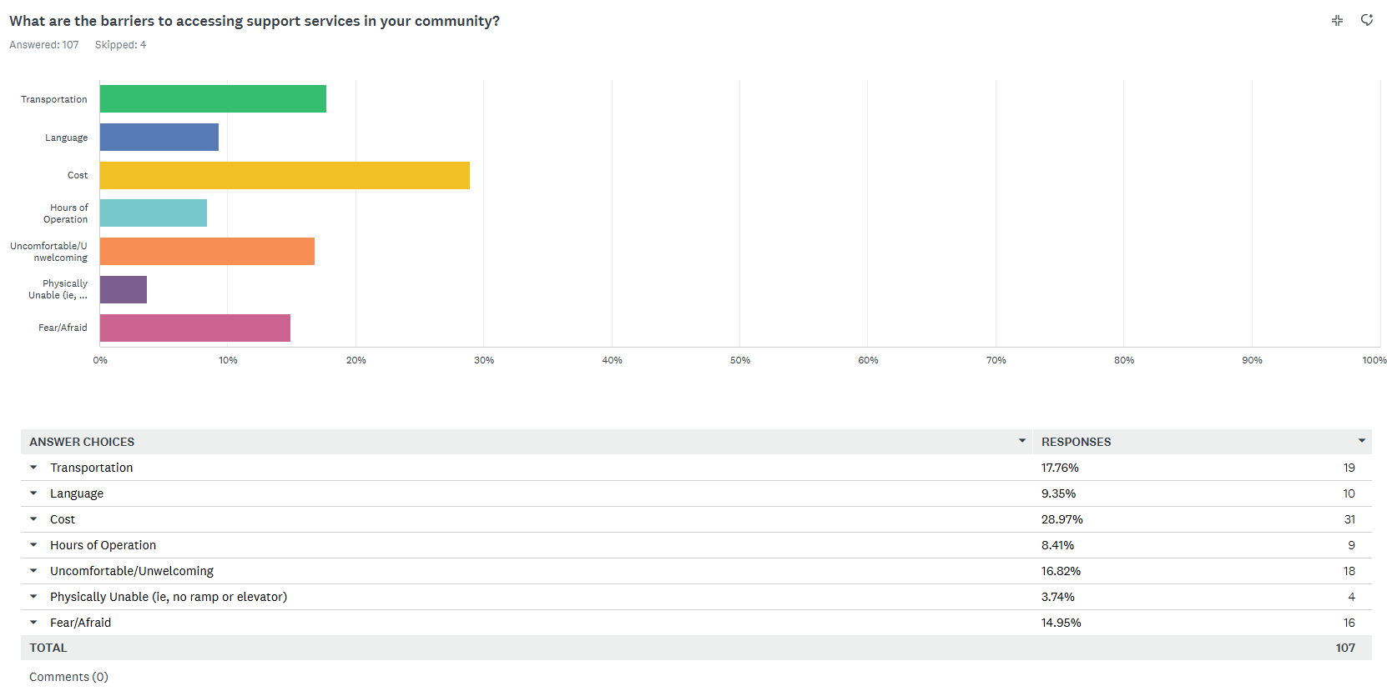

Slide 8
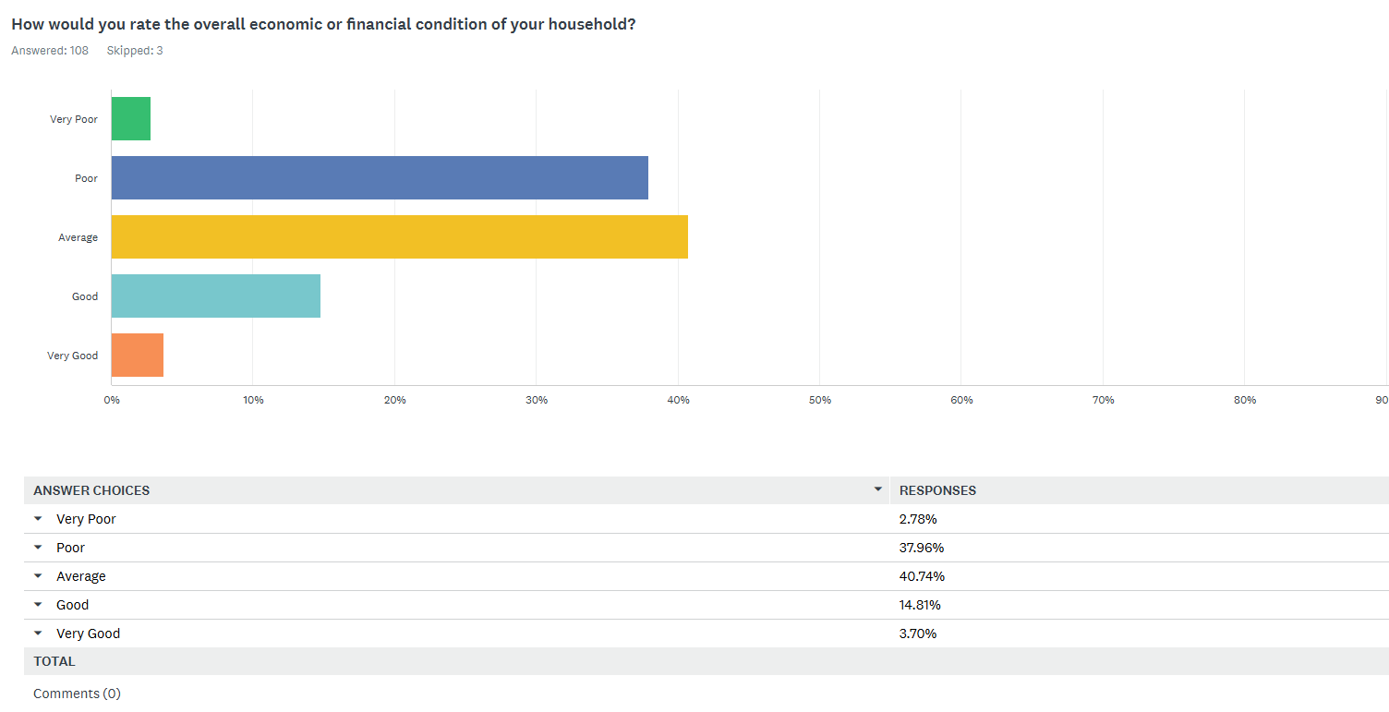

Slide 9
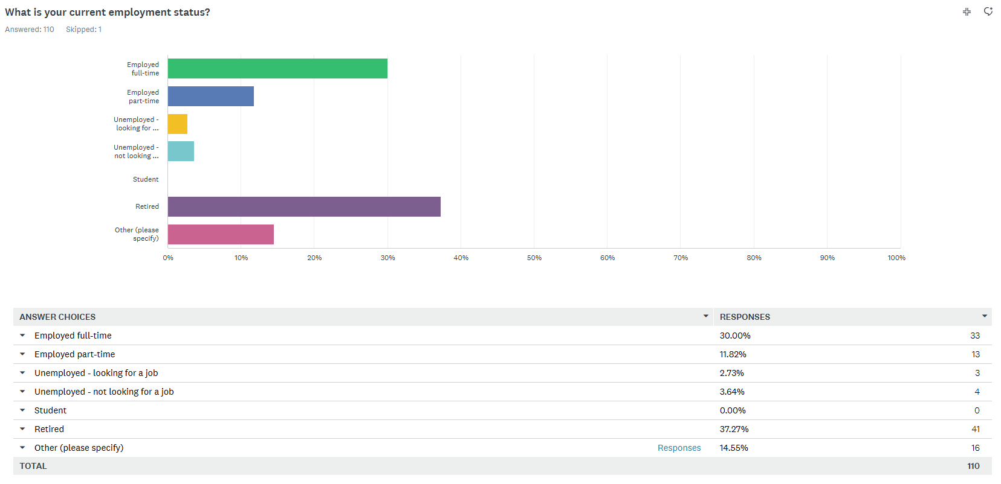

Slide 10
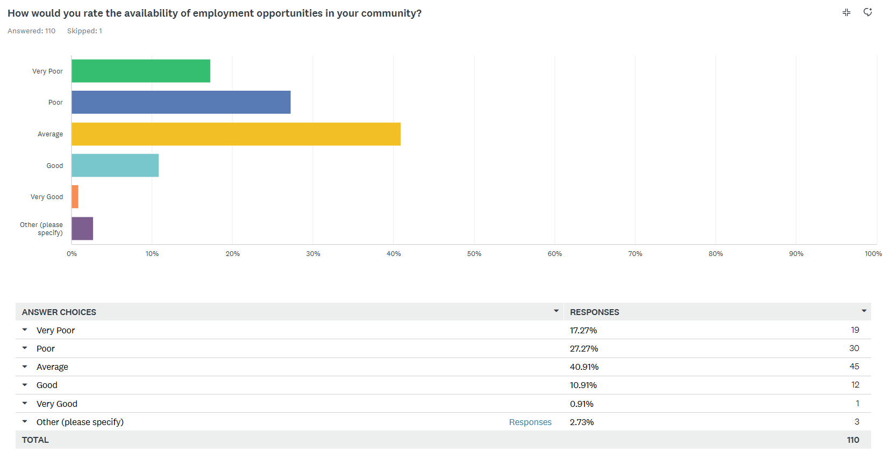

Slide 11
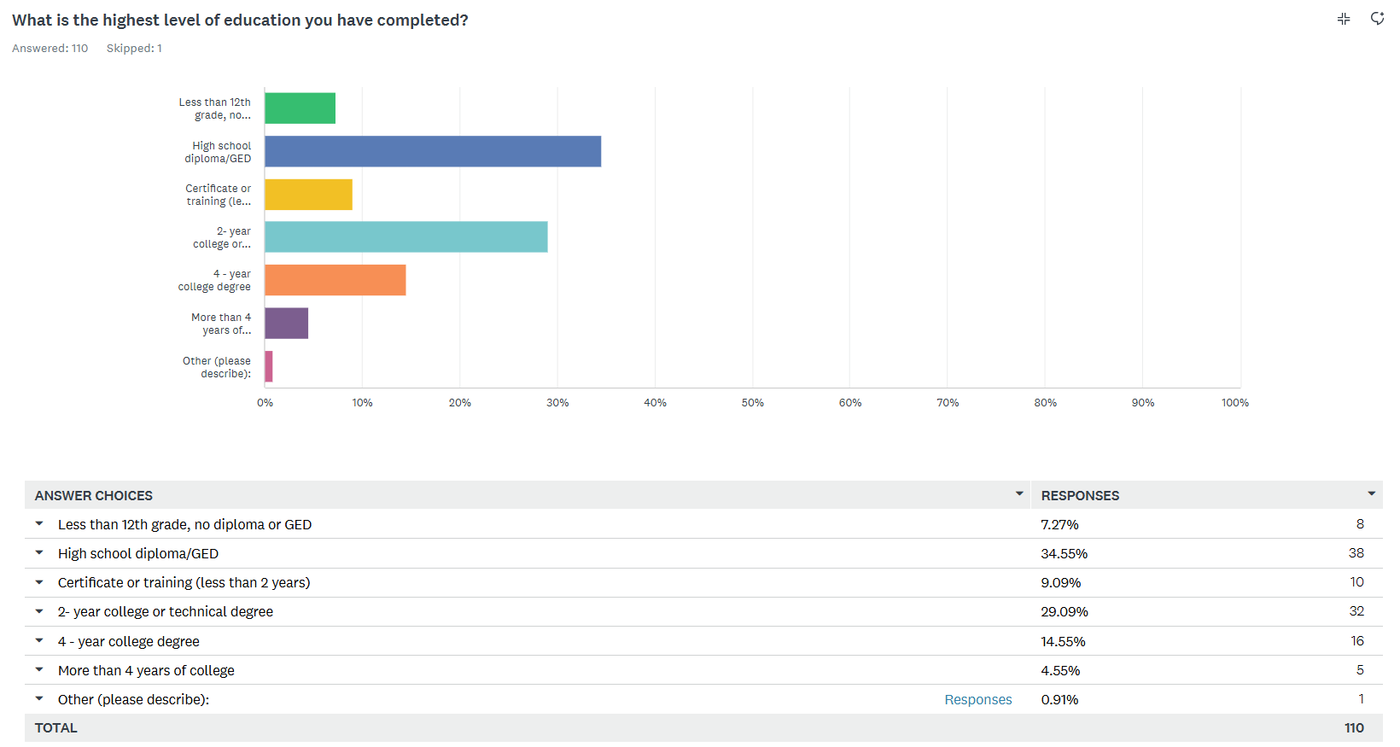

Slide 12
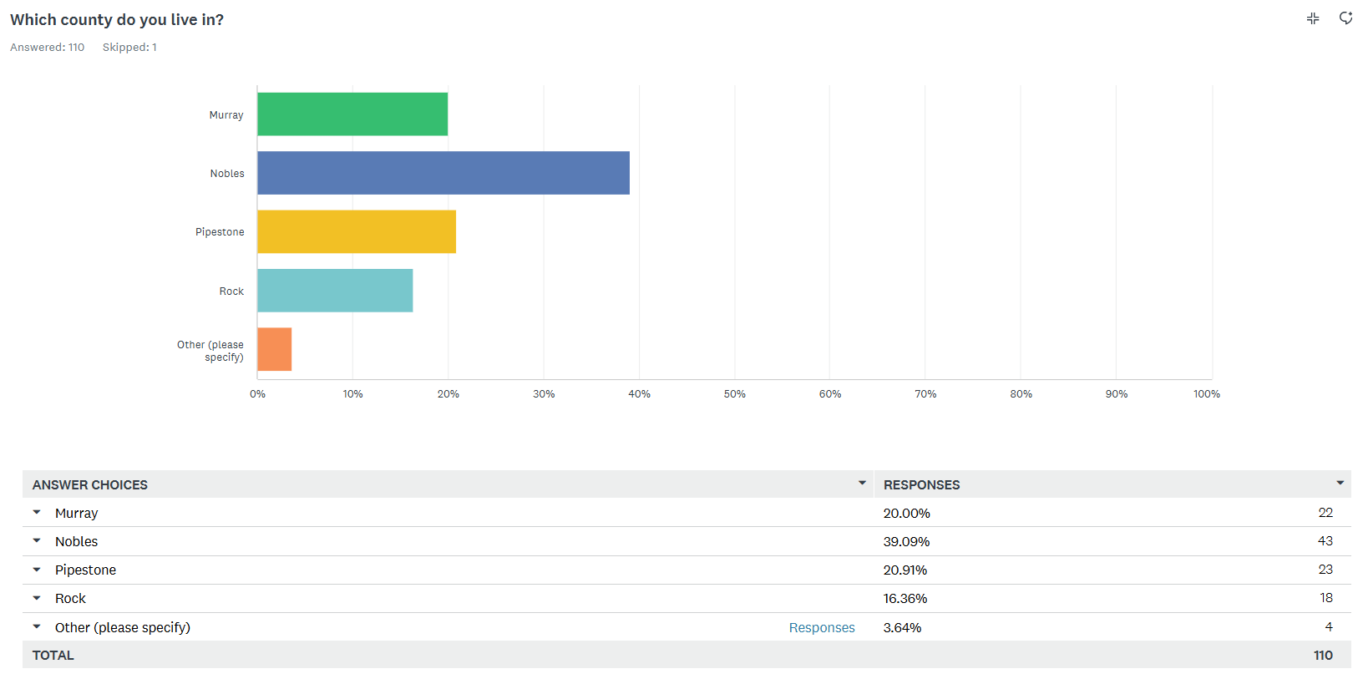

Slide 13
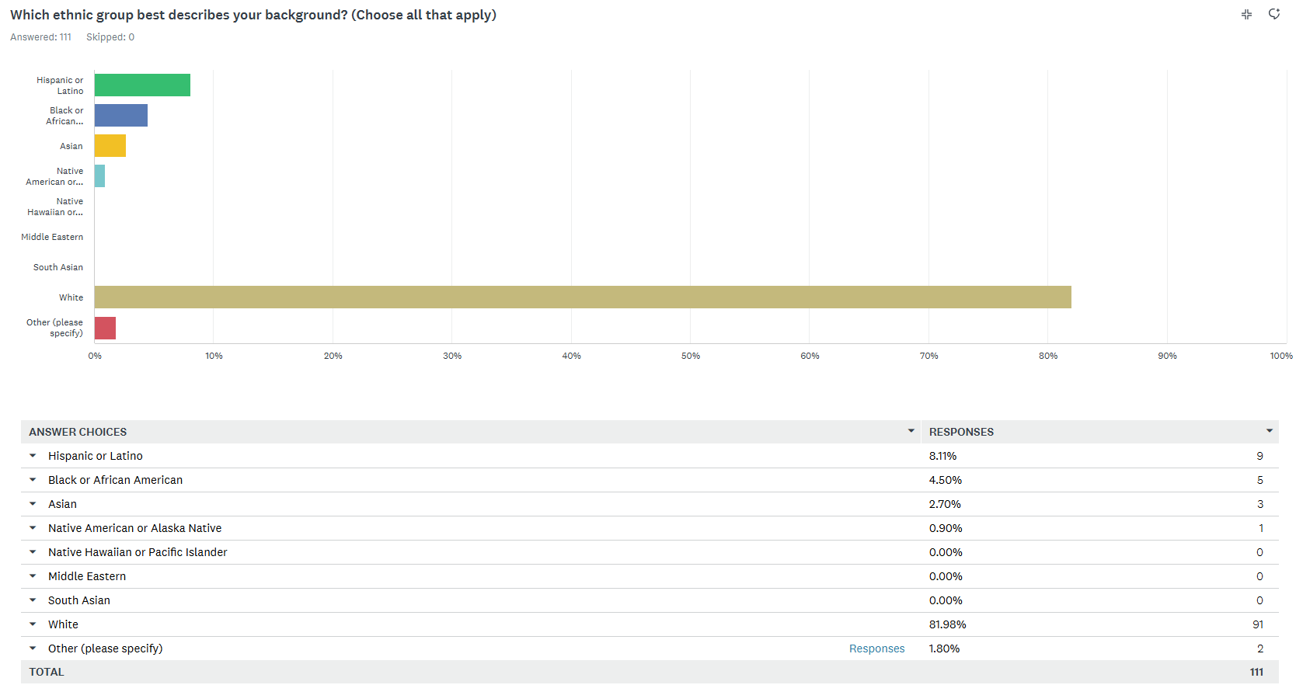

Slide 14
Key Takeaways:
Top areas of concern:
  High cost of living
  Low wages
  Lack of affordable housing
  Lack of employment opportunities
Top areas to improve services:
  Housing/Homeless services
  Affordable housing options
  Job training programs
  Healthcare services
  Educational scholarships

